Slide 1
Hyland Hackathon
2 0 2 3
Mentor Prep Meeting
Notes:
Hello everyone!
Thank you so much for signing up to be a mentor for this years 2023 Hybrid Hyland Hackathon!
My name is Marissa- I’m a Project Manager here on the Tech Outreach team. I’ve been at Hyland for about 2 years, and this is my 3rd Hackathon.
*Next Slide*
Links to have pulled up:
https://docs.google.com/document/d/1M31b103uPJ0QPDhUd_yfEFY_nJCXtzjENKnbk2AYvnA/edit
https://hylandtechoutreach.github.io/hackathon/Schedule.html

Slide 2
Thank you!
We truly could not do this without you 🥺
Notes:
We truly could not have this event without your help. I’ll say it a million times today, but thank you so much!
*Next Slide*

Slide 3
👋
Introductions
Tell us your name, role, location, and previous experience!
Notes:
Now, I want to get to know all of you!
If you could share your name, your role, where you’re located, and any previous experience you may have with Hackathons or any Tech Outreach program.
*Call on someone to kick-off*
*Next Slide*

Slide 4
Agenda
The Basics
Student Context
Expectations
In-Person
Essential information about where to go and how things work
Things the student should know
How to be the best mentor you can be
Information for
in-person mentors
Notes:
Thank you so much for sharing more about yourself! Let’s go over the agenda for today:
The basics, where I’ll cover essential information
Student Context, where you’ll learn what information we’re giving to students and what they should know
I’ll then talk about expectations for you all, and how you can be a great mentor!
After I cover expectations, anyone who is a virtual mentor is free to leave! Then I’ll dive into the logistics of in-person mentorship.
Please let me know if you have a question at any point in time– I’ll leave time at the end for questions as well.

Slide 5
The Basics
Essential information about where to go and how things work
Notes:
Let’s go over basic information about our event
*Next Slide*

Slide 6
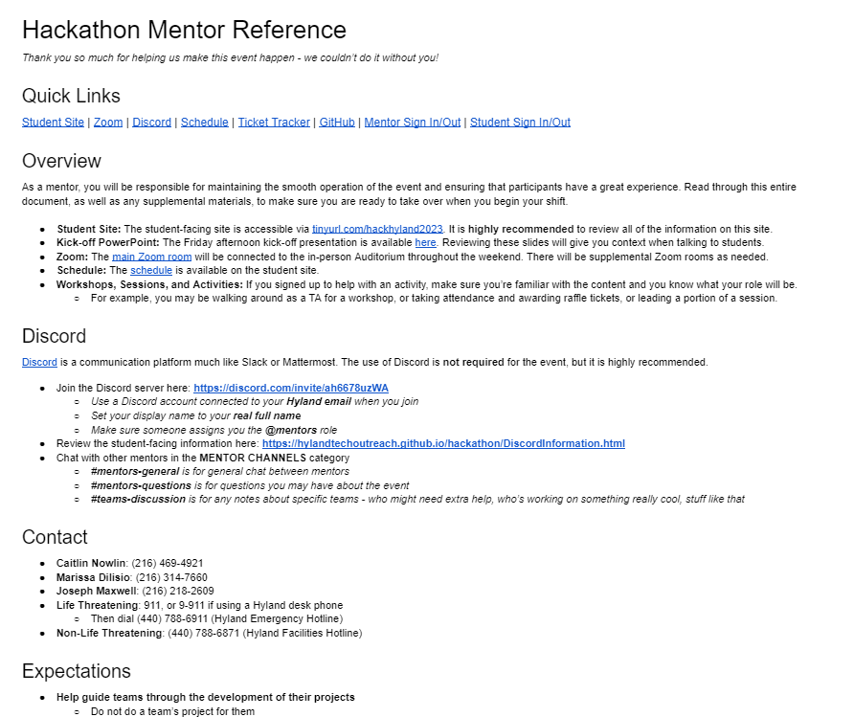
Mentor Reference Document
https://docs.google.com/document/d/1M31b103uPJ0QPDhUd_yfEFY_nJCXtzjENKnbk2AYvnA/edit
PLEASE read through this document before your shift begins 🥰
Notes:
Here is a link – which I will share in the chat with you all, as well as in an email– that will have everything you need to know to be successful this weekend! Think of this as your mentor playbook.
You’ll have quick links, and overview, Discord information, contact information and more!
https://docs.google.com/document/d/1M31b103uPJ0QPDhUd_yfEFY_nJCXtzjENKnbk2AYvnA/edit
You’ll want to keep this open throughout your shifts, and you’ll definitely want to read through it before your shift begins!
*Next Slide*

Slide 7



Places
Mentor Reference Document: Your one-stop-shop for all Hackathon information!
Teams: We will use this to communicate leading up to the event (sorry Slack people ☹)
Discord: We will use this to communicate during the event
Student Site: This is the main source of information for the students
Zoom: All activities will be broadcast via Zoom (all but one in the Main Zoom Room)
Notes:
Here are the important places to keep an eye on before, during and following the hackathon!
Again, the mentor reference document (can you tell it’s important?)
Teams – sorry to those of you who use slack! This is where we will communicate leading up to the event
Discord– This is where we will communicate with each other and with students during the event
Student Site– the main source of information for students
Zoom – All activities will be broadcasted via Zoom for our virtual participants and mentors.
*Next Slide*

Slide 8
Schedule
https://hylandtechoutreach.github.io/hackathon/Schedule.html
Important Times
Friday, 4pm ET: Event Kickoff
Friday, 5pm ET: Team Submissions Due
Saturday, 9am ET: Day 2 Kickoff
Sunday, 1pm ET: Entry Round Submissions Due*
Sunday, 4pm ET: Final Round Begins*
Sunday, 6pm ET: Closing Ceremony*
*Subject to change
Notes:
Now for the fun stuff- our schedule for the weekend!
As an overview:
Friday, 4pm ET: Event Kickoff
Friday, 5pm ET: Team Submissions Due
Saturday, 9am ET: Day 2 Kickoff
Sunday, 1pm ET: Entry Round Submissions Due*
Sunday, 4pm ET: Final Round Begins*
Sunday, 6pm ET: Closing Ceremony*
The full schedule can be seen on the student facing website, which will be shared with students prior to the event. You all can access this schedule via the Mentor Reference Document.
*next Slide*

Slide 9
Workshops & Sessions
Schedule and student materials available at tinyurl.com/hackhyland2023
Lesson plans available on GitHub
Be aware of when these are happening, and encourage students to attend when applicable
If you’re helping with one of these, make sure you know the material and know your responsibilities!
Notes:
The full schedule includes times for activities, workshops, and meals (for those joining us in-person!). Students will likely be asking questions about these times, so you’ll want to direct them to this website each time!
Lesson plans available on GitHub ( I will send this link out following this meeting as well!)
Be aware of when these are happening, and encourage students to attend when applicable
If you’re helping with one of these, make sure you know the material and know your responsibilities!
*Next Slide*

Slide 10
Student Context
Things the student should know
Notes:
Any questions about the mentor content before we move into what content the students will have access to?
*Next Slide*

Slide 11
Student Site
https://tinyurl.com/
hackhyland2023
Notes:
This is the site they will be using at all times!
When I say this site has everything- I mean everything! From Zoom information, to schedule, and everything in between,. This is the website students will want to bookmark and reference throughout the weekend!
*Pull up website to briefly go over*
*Next Slide*

Slide 12
New This Year: Tracks!
Explorer
Artisan
Scientist
🚀
🖌
🧪
For students who are just beginning their voyage into the world of software development
For students with some programming experience who are interested in the creative aspects of development
For students who love the technical details of projects and have significant programming experience
Students will select tracks when they submit their team roster on the first night
Notes:
You may have noticed a “Track” section on the sidebar of the student website. This is new this year!
Students will select which track they’d like to be a part of when they submit their team roster on the first night. Students have 3 tracks to choose from:
Explorer (for students new to coding and software development)
Artisan (for students with some programming experience, but are mostly interested in the creative aspects of development)
And Scientist (for those who love the technical details of projects and have some programming experience)
Members of a team can all choose the same track, or all chose different ones! Choosing a track doesn’t limit them in any way during the Hackathon- it simply provide additional resources and guidance. The tracks are simply meant to guide you through the Hackathon and give you an idea of what to do.
*Next Slide*

Slide 13
Competiton Rules
Fresh Code
Ownership
Teams can have up to 5 students
Only work created during the Hackathon is allowed to be included in projects
Teams have full ownership of projects created during the Hackathon
Notes:
Now for the rules that we’ve given participants:
Teams can have up to 5 students! If a team has more than 5 participants, we will need to ask them to split up. We have been doing this hackathon since 2015, and have found this to be the sweet spot!
Fresh code only! Only work created during the Hackathon is allowed to be included in projects. If you are assisting students with their code, and suspect they may have used previously worked on code, please remind them that the project must have been started from scratch.
Last but not least, teams have full ownership of projects created during the hackathon!
Any questions?
*Next Slide*

Slide 14
Judging Process
Entry Round
Mentors should help teams prepare their entry round submissions
Resources available to help students record presentations
Videos (2-3min) due by 1pm ET on Sunday
Volunteer judges will fill out rubrics and calculate total scores
Top 4 teams from each grade level will advance
More volunteers are needed to watch videos from 1:30-3:30pm!
Final Round
Top 8 teams present live (<5 mins) in front of judges, 4-6pm ET Sunday
Judges will ask questions
Judges pick the first and second place team from each grade level, and every member of those teams will win a prize!
Criteria
Innovation
UX
Quality
Impact
Notes:
There are 2 rounds for judging: the Entry Round and the Final Round.
Each round will be judges on the following criteria: Innovation, User Experience, Quality and Impact. You will want to keep these criteria in mind as you’re assisting students with their projects throughout the weekend.
The first round, the entry round, will go as follows:
Entry Round
Mentors should help teams prepare their entry round submissions
Resources available to help students record presentations
Videos (2-3min) due by 1pm ET on Sunday
Volunteer judges will fill out rubrics and calculate total scores
Top 4 teams from each grade level will advance
More volunteers are needed to watch videos from 1:30-3:30pm! Please let me know if you’d like to assist in watching the video submissions!
Even if students do not make it into the final round, we do encourage them to stick around. Giveaway prizes will be announced, and for those in-person pasrticipants, dinner will be served at this time as well! It’s also great to stay and watch the final presentations to get an idea of what the judges found to meet or exceed the criteria!
Then, we will have the final round:
Final Round
Top 8 teams present live (<5 mins) in front of judges, 4-6pm ET Sunday
Judges will ask questions
Judges pick the first and second place team from each grade level, and every member of those teams will win a prize!

Slide 15
Prizes*
First Place
Razor Electric Scooter OR Bose Noise-Canceling Earbuds
Second Place
Pixel Art Bluetooth Speaker OR LED Jellyfish Lamp
Physical Giveaway Prizes
Candy, Rubber Ducks, Stuffed Animal, Water Bottle, Grab Bag
Digital Giveaway Prizes
Audible Credit, A.I. Portraits, A.I. Poetry, Custom Synth Track, Udemy Course
*prizes may vary
More Info Coming Up 🎫
Notes:
All of these prizes are subject to change based on availability, but here's what we got!
- All team members from both first place teams will choose between a scooter and earbuds
- Second place teams will choose between a bluetooth speaker and a jellyfish lamp
- Giveaway winners will have some random prizes available
We'll talk more soon about how students can win the Giveaway prizes!

Slide 16
Expectations
How to be the best mentor you can be
Notes:
Let's talk about your expectations as a mentor at this Hackathon.

Slide 17

What To Do
More details are listed in the Mentor Reference Document
Guide Teams
Lead them to discover their own solutions – point to online resources
Keep the judging criteria in mind
Be Present
Monitor the Discord for questions or misbehaving
If no one’s asking for help – reach out!
Chat with other mentors, and let Caitlin, Marissa, or Joseph know if anything’s up
In-Person: Be Responsible
Supervise students, hand out snacks, enforce rules
Sign in/out on the digital Mentor sheet when you arrive/depart
Be available for students to sign in/out
Notes:
So, what do you do as a mentor? Your main purpose will be to guide teams through the creation of their projects. The biggest thing is to make sure you're leading them to discover their own solutions - don't do their projects for them! You can point them to online resources, nudge them in the right direction, and give them what they need to continue. Always keep the judging rubric in mind when you're helping them - their ultimate success in the competition will be based on those criteria.
You'll also want to stay present, whether you're virtual or in-person. Monitor the Discord (more info on that soon), reach out if no one's talking, and let someone know if you spot an issue.
If you're an in-person mentor, you'll also be a supervisor. You may need to hand out snacks if they're running low, and you'll definitely need to enforce the rules. You will have to sign in and out when you arrive and depart, and you'll also need to be available for students to sign in and out.
All of these things will help you be the best mentor you can be!

Slide 18

Discord
More information available in the Mentor Reference Document
Discord is a communication platform like Slack or Mattermost
The use of Discord is not required
Discord is highly recommended, especially for virtual mentors
Given the @mentors role, you can access secret channels, and be notified when someone needs help
Prep Channels
For use before the event – feel free to peruse and help facilitate team connections or answer questions!
Event Channels
For use during the event – please monitor these channels during the event
Division Channels
Channels for students based on their grade level, track, and location
Off Topic Channels
At this point, just a counting channel where students count and discuss the counting
Mentor Channels
Only mentors will be able to access these channels
Hacky Hyland, Jr
A bot to help facilitate Discord interactions
Notes:
As mentioned previously, we will be using Discord to communicate during the event. If you're not familiar, it's a lot like Slack or Mattermost. Note that Discord is not required, but it is highly recommended. Once you join, you'll become a mentor, and be able to access secret channels and get notifications when @mentors are tagged.
There are a wide variety of channels in the Hackathon server - some for preparation, some for the event, some for each individual division, some for fun, and some for mentors only. Please check all of them as needed.
We also have a little bot that will do some monitoring. At this point, it mainly exists to regulate the messages in the counting channel, but it may also have some other capabilities by the time the event begins!

Slide 19
Tickets
More information available in the Mentor Reference Document
YOU will give out tickets for the end-of-event giveaway!
Students can earn tickets by:
Attending a workshop or session
Answering a question on Discord
Being extra friendly to a new teammate
Winning a game
Much more!
Q: How?
A: Using the Ticket Tracker Google Sheet!
Click the UPDATE TICKETS button
Select student(s) from the checklist
Enter a reason
Select the number of tickets
Click Submit
Mentors assisting with workshops may be asked to give tickets to all students in attendance
Notes:
Now let's talk about Tickets. This will be a way to recognize students for their efforts throughout the weekend. You can find more information in the Mentor Reference Document, but here's a quick rundown:
You can decide to give tickets to students at your discretion
Students may win prizes based on the tickets they earn at the end-of-event giveaway
You can reward things like attending a workshop, helping out on discord, or anything else you see!
All tickets are fully virtual. When you want to give a ticket to a student, you can use our Ticket Tracker Google Sheet. You'll click a button, fill out the info for the ticket (or tickets), and submit it. There are more detailed instructions in th Reference Document.

Slide 20

Superlatives
Is there a student who stands out in some way? Nominate them for a superlative!
Adventurer: Venturing the furthest out of their comfort zone
Fashionista: Dressing the best
Night Owl: Getting the least amount of sleep
Scholar: Learning the most
Coach: Helping the most
Pioneer: Using the most cutting-edge technology
Comedian: Making people laugh the most
Procedure
Nominate by posting in Discord or Teams
This is fully optional, and no superlatives are guaranteed
Notes:
Another thing to keep in mind as you're working with students is superlatives. If any student stands out in any way, we may want to recognize them! This could be things like dressing well, staying up late, helping others, or anything else that sets them apart. If you think any student would qualify for these titles, you can nominate them by posting in Discord or Teams!
Note that we may not end up announcing any superlatives if no students end up standing out - so nothing is guaranteed. It's totally optional!

Slide 21
In-Person Info
Virtual mentors are free to go!
Notes:
Next up we'll be going through some things that are specific to in-person mentors. Virtual mentors are free to go!

Slide 22
In-Person Rules
More details are listed in the Mentor Reference Document
Access
Students must enter and exit through the B3 Employee & Training Entrance
Students may only access the first floor of the Core and D Wing
Students must sign in and sign out with a mentor every time the arrive or depart
Rooms
The OSU Auditorium will be used as a quiet area when events are not happening
Some “Raffle Rooms” will be available to randomly chosen teams for the duration of the event
Students are allowed to get drinks from the break rooms
Quiet Rooms can be used for students to record their entry round videos, limited to 1 hour
Bathrooms
Students should only use the bathrooms off the volleyball court
They are welcome to use the showers in those bathrooms
Notes:
There are several rules the participants will need to follow when they're here in-person.
Students should only enter and exit through the Employee Training Entrance - NOT the main entrance on the second floor
Students should not enter the A Wing, B Wing, or ANYTHING upstairs
Students will ALWAYS sign in and sign out if they have to leave the building for any reason. This will help us keep track of everybody
The OSU Auditorium will be a quiet area when there are no events
There will be Raffle rooms - random teams will be able to claim these rooms. The door should remain open throughout the event, and capacity must be respected.
Students are allowed to get drinks from the break room
The little Quiet Rooms by the Innovation Lounge (different from the Quiet Area in the auditorium) can be used for students to film their videos - only for one hour at a time.
Only the bathrooms in the core should be used, and students are encouraged to use the showers in those bathrooms

Slide 23
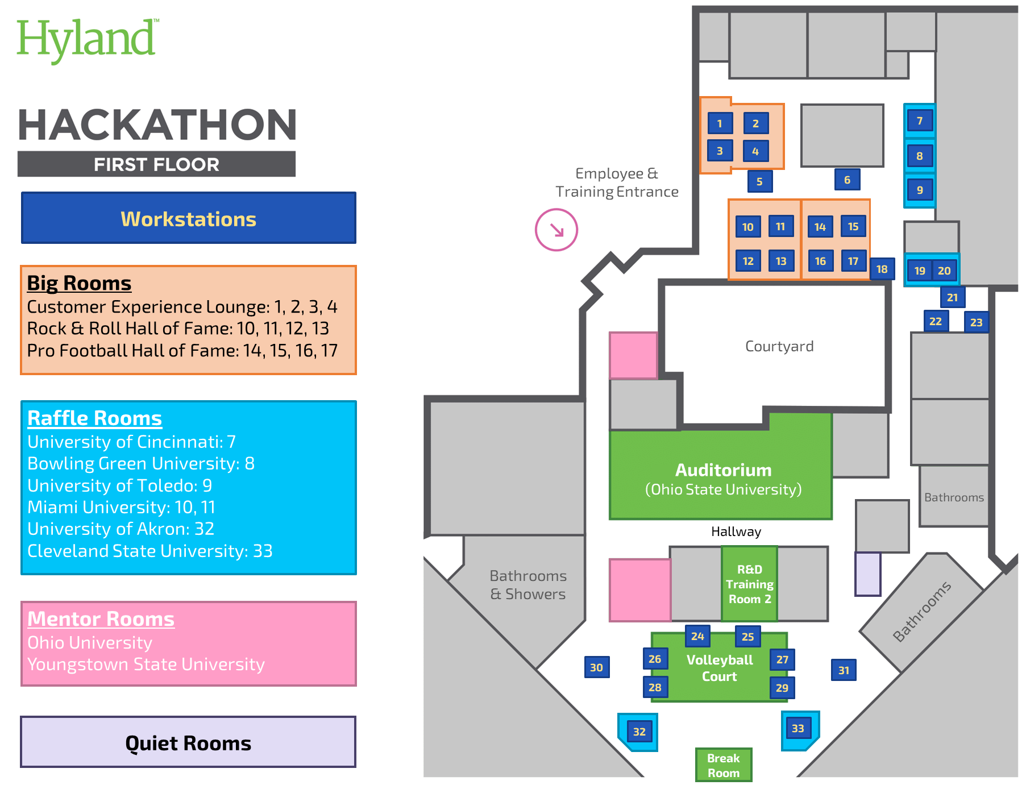
Map
Notes:
We should have an actual map soon, but here are some important notes about how we will use Building 3 throughout the event.
We will be in the Core and D Wing
Tables will be setup throughout
Some rooms, like the Ed Services Training Rooms, will be totally off-limits for the whole weekend
There should be signage to help students navigate the building
The two Mentor Rooms will be YSU and OU - one right by the Entrance, and one off the volleyball court

Slide 24

Contact
Emergency
Facilitators
🆘
Life Threatening: call 911
or 9-911 from a desk phone
Then, call the Hyland Emergency Hotline:
(440) 788-6911
Non-Life Threatening: call the Hyland Facilities Hotline at (440) 788-6871
Marissa: (216) 314-7660
Joseph: (216) 218-2609
Caitlin: (216) 469-4921
🆘
Set up
in the Mentor Room
🆘
Notes:
If you need to get ahold of someone, here's how you can do it. All of this information is listed in the Mentor Reference Document, so you don't need to memorize it all.
You should call 911 if there is a life-threatening emergency (or call 9-911 from a Hyland desk phone). We'll also ask you to call the Hyland Emergency Hotline. For non-life threatening situations, you'll want to call the Hyland Facilities Hotline.
You'll also be able to reach Marissa, Joseph, and Caitlin during the event - one of them will be on-call for almost the entire weekend.
When you're on-duty, hang out in the Mentor Room to keep up with other mentors, and be available to help students if they need it.

Slide 25
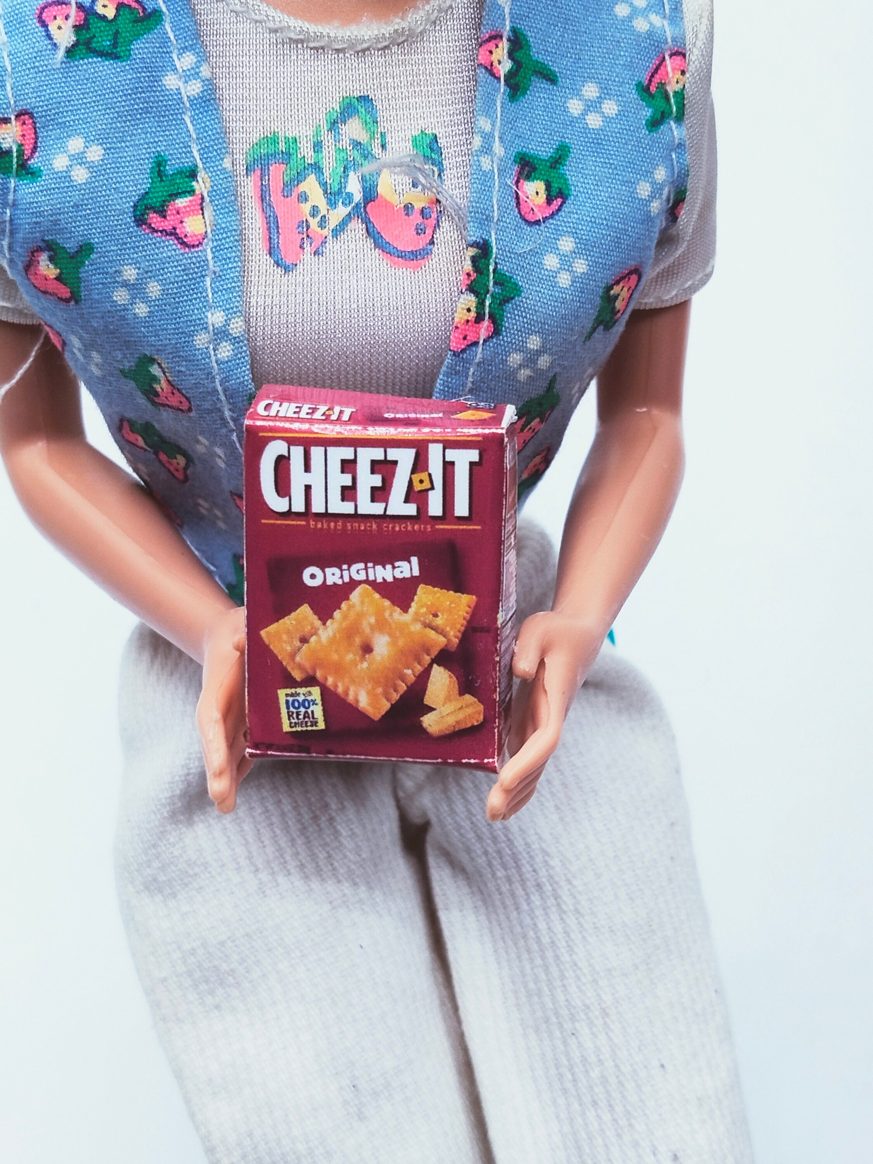

T-Shirts & Snacks
Pick up your shirt to make sure you stand out as a mentor!
Feel free to partake of the many snacks available!
Notes:
As an in-person mentor, you get a free shirt! Make sure to pick it up and wear it during your shift so that you stand out as a Hylander.
We will also have a bunch of snacks available - feel free to eat them, and also hand them out to students as needed.

Slide 26

Food & Beverages
Breakfast, Lunch, and Dinner will be served each full day of the Hackathon! Specifics TBD
Notes:
We will be serving meals at designated times throughout the weekend - make sure to check the schedule to see when! Here's what we're getting:
Friday: Jet's Pizza for Dinner
Saturday: Giant Eagle Sandwiches for Lunch, Giant Eagle Chicken Tenders and Mac n Cheese for Dinner
Sunday: Jimmy John's for Lunch, Giant Eagle Pasta for Dinner
Feel free to take some food for yourself. If you have a shift scheduled during a meal, we can always use extra help setting up, serving, and cleaning up!

Slide 27

THANK YOU!
Any questions?
Notes:
Thank you so much!
What questions for you have??

